Slide 1

Working with Dynamics CRM Workflows

Slide 2

Mitch Milam
Dynamics CRM Architect
Independent consultant and trainer
Ten-Time Dynamics CRM MVP
mitch@xrmcoaches.com
infinite–x.net
@mitchmilam

Slide 3
Agenda
Process Automation
Workflow Design and Configuration
Troubleshooting and Management
Extending Workflows

Slide 4
Automating a Process

Slide 5
What are you Automating?
Lead to Customer
Opportunities
Other

Slide 6
First Things First
You must have a process to automate!

Slide 7
First Things First
You must have a clearly defined process to automate!

Slide 8
Mitch’s Rule #3
Technology does not solve process issues

Slide 9
Process Mapping
Document existing process steps
Get agreement from all parties
Determine technology requirements
Create the workflow(s)

Slide 10
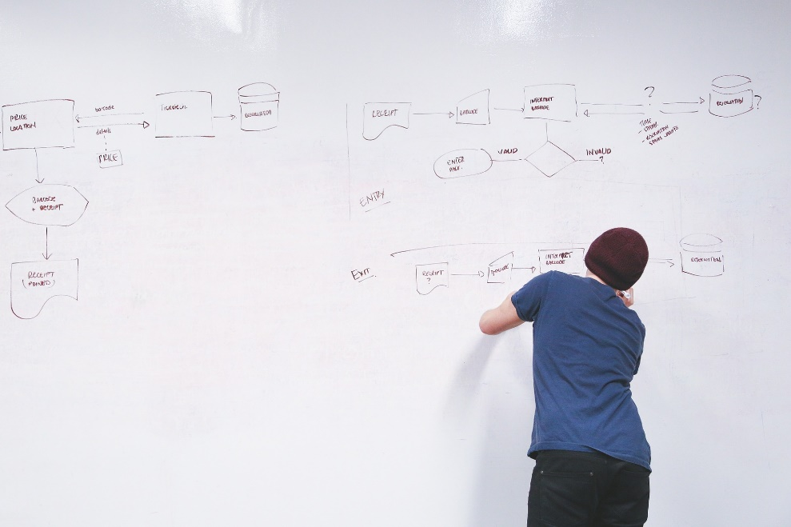


Getting Started

Slide 11
Workflow Design

Slide 12
Workflow Design
Simple is better than complicated

Slide 13
Workflow Design
If you can’t explain how it works to another person, then it is too complicated.

Slide 14
Workflow Design
Always keep maintenance in mind

Slide 15
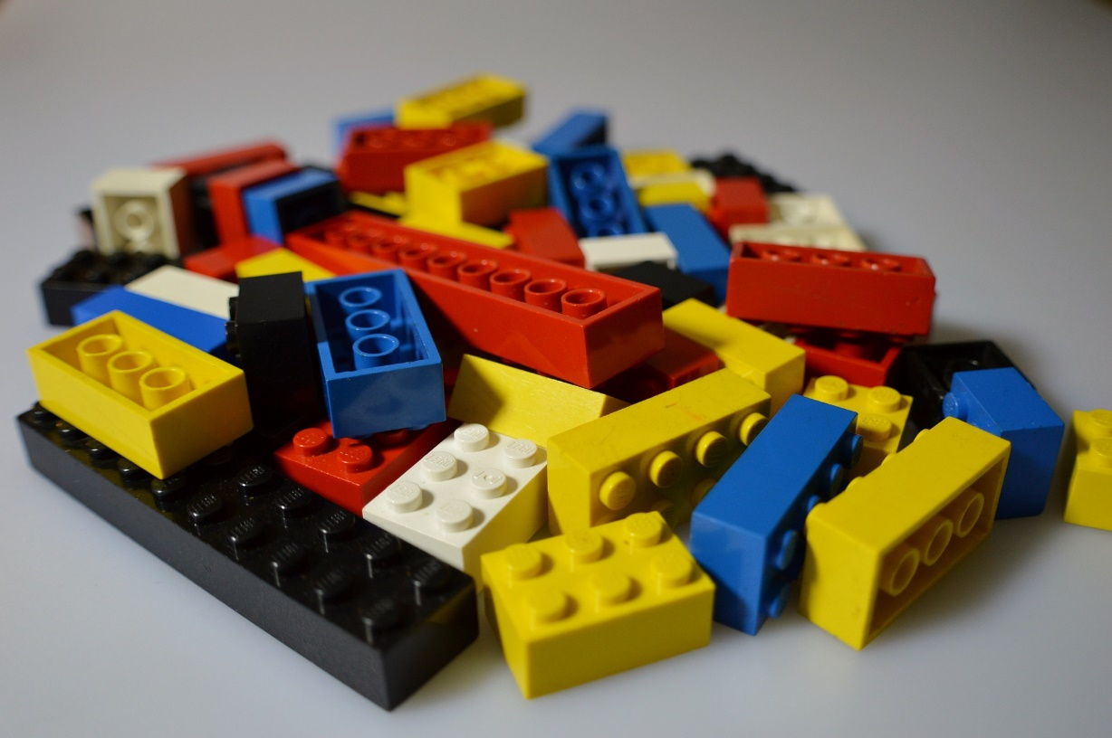
Workflow Design
Build Blocks

Slide 16

Workflow Design
Use Blocks to Make Structures

Slide 17
Workflow Design
Workflow
Step
Step
Step
Step
Step
Step
Master Workflow
Child Workflow
Step
Step
Child Workflow
Step
Step
Step
Child Workflow
Step
Child Workflow
Step
Step
Step

Slide 18
Workflow Design
Master
Child 1
Child 3
Child 4
Child 2

Slide 19
Workflow Configuration

Slide 20
Workflow Design
Considerations

Slide 21
Naming Convention
Select a naming convention that makes sense to you
Parent vs. child workflows
Purpose (admin, marketing, sales)

Slide 22

Available to Run

Slide 23
Scope
User
Business Unit
Parent: Child Business Units
Organization

Slide 24
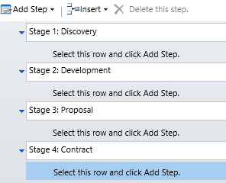
Step: Stage
Allows you to group a series of workflow steps
If a workflow has stages, then all steps must belong in a stage

Slide 25
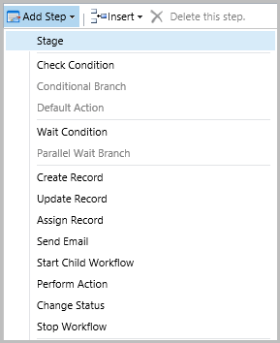
Steps

Slide 26
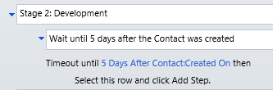
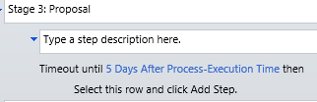
Wait vs. Timeout
Timeout
Waits for a specific amount of time or until a specific date

Slide 27
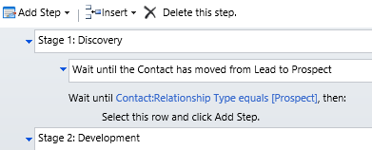
Wait vs. Timeout
Wait Condition
Waits until a specific action has occurred

Slide 28
Long-Running Workflows
How do we handle long-running workflows (months, years, etc.)?
Timeout
Batch process
Other

Slide 29
Remember
One a workflow starts, it cannot be changed

Slide 30
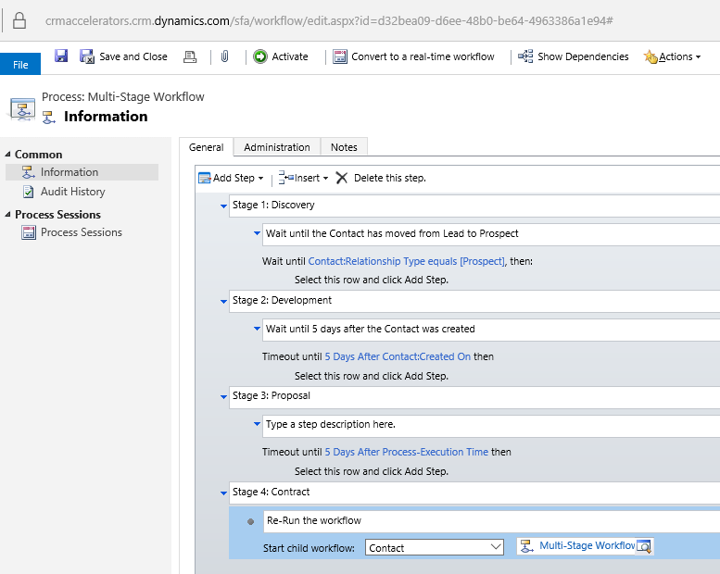
Restarting the Workflow

Slide 31
Extending Workflows

Slide 32
Additional Resources
CRM DateTime Workflow Utilities
Add Business Days
Add Days
Add Hours
Add Minutes
Add Months
Add Years
Date Difference Days
Date Difference Hours
Date Difference Minutes
Date Difference Months
Date Difference Years
Get Day Number Of Week
Get Day Number Of Year
Get Day Of Week
Get Quarter Number Of Year
Get Week Number Of Year
Get Month Start/End Dates
Get Quarter Start/End Dates
Get Week Start/End Dates
Get Year Start/End Dates
Is Between
Is Business Day
Is Same Day
Relative Time String
ToDateTime
To UTC String

Slide 33
Additional Resources
CRM Email Workflow Utilities
Email Business Unit
CC Business Unit
Email Security Role
CC Security Role
Email Team
CC Team
Delete Email Attachments
Delete Email Attachments By Name
Send Draft Email

Slide 34
Additional Resources
CRM String Workflow Utilities
Contains
Create Empty Spaces
EndsWith
Join
Length
PadLeft
PadLeft Dynamic
PadRight
PadRight Dynamic
Regex Match
Regex Replace
Replace
Reverse
StartsWith
Substring
ToLower
ToTitleCase
ToUpper
Trim
Word Count

Slide 35
Additional Resources
CRM Numeric Workflow Utilities
Add
Average
Divide
Max
Min
Multiply
Random Number
Round
Subtract
ToDecimal
ToInteger
Truncates

Slide 36
Additional Resources
MS Dynamics CRM 2011 Bulk Workflow Execution Tool
From ZeroToTen

Slide 37
Troubleshooting and Management

Slide 38
Workflow Failures
Two types of failures
Soft
Hard

Slide 39
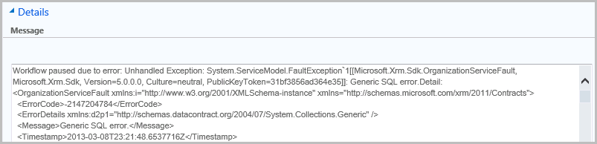
Error Example

Slide 40
Reviewing System Jobs
Build Personal Views
Monitor system jobs on a regular basis
Take action to correct issues
1
2
3

Slide 41
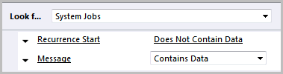
Personal View #1
System Jobs with Messages

Slide 42
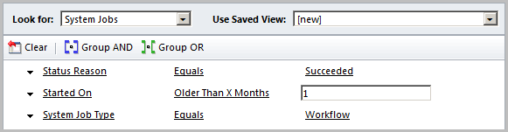
System Job Management: Bulk Delete
Remove successful workflows

Slide 43
Demonstration

Slide 44
Discussions

Slide 45
Questions?

Slide 46
Thank You

